Slide 1
Novosibirsk group activity
Andrey Sokolov,
Budker INP, Novosibirsk State University,
Novosibirsk, Russia

Slide 2
Activity directions
Study of fundamental argon properties using x-ray and neutrons;
Using a matrix of SiPMs for the registration of the electroluminescence in NUV and NIR;
Study of argon doping by nitrogen.

Slide 3
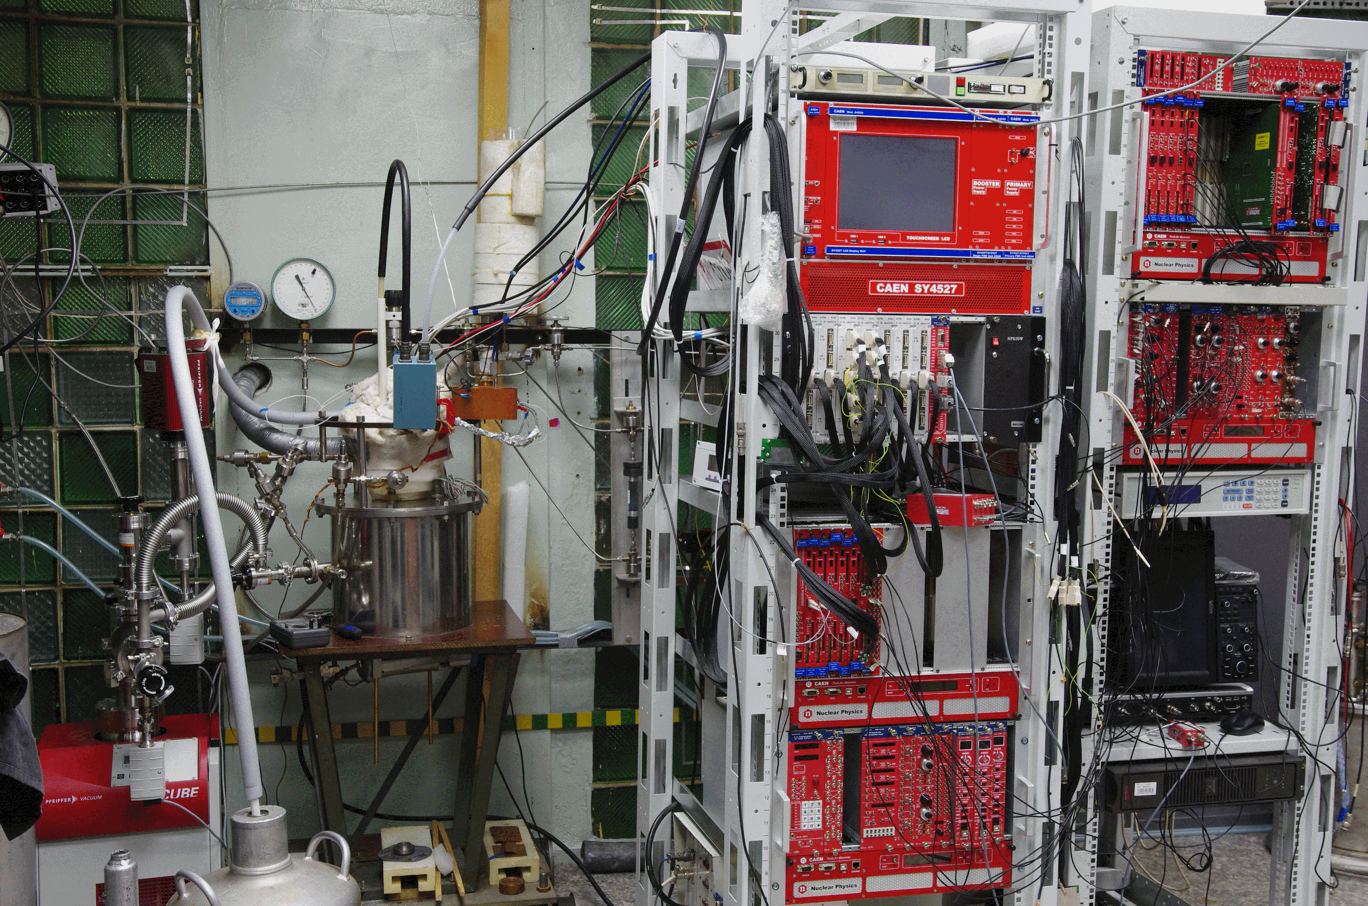
Experimental setup with the 9 liters cryogenic chamber

Slide 4
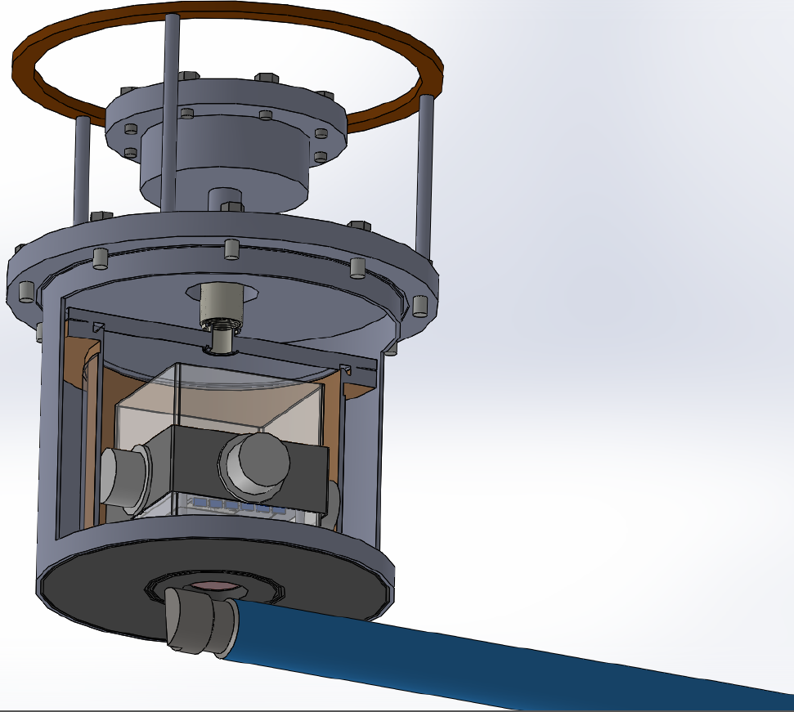
Chamber 3D - view

Slide 5
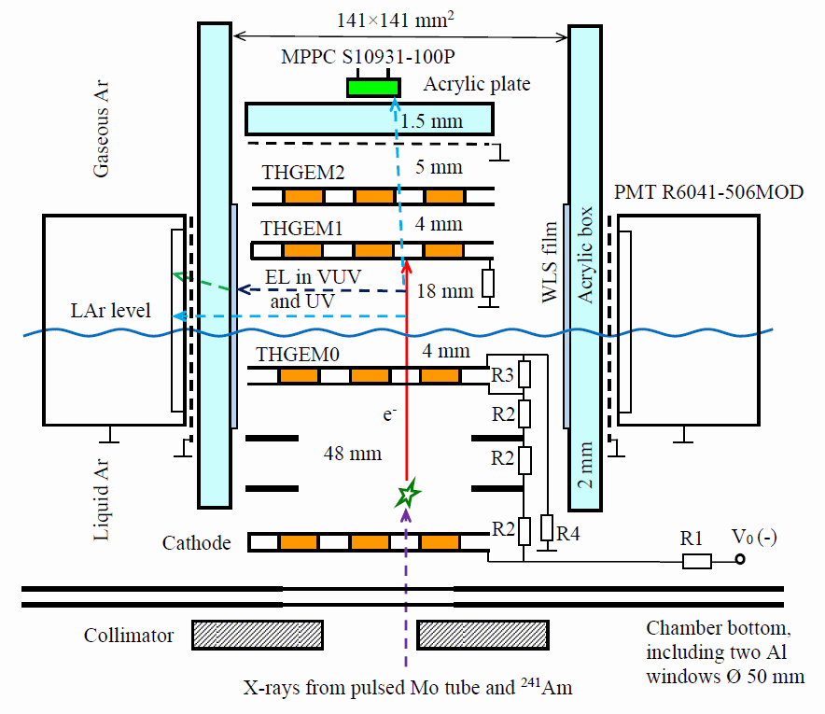
Proportional EL in two-phase Ar: Experimental setup

Slide 6
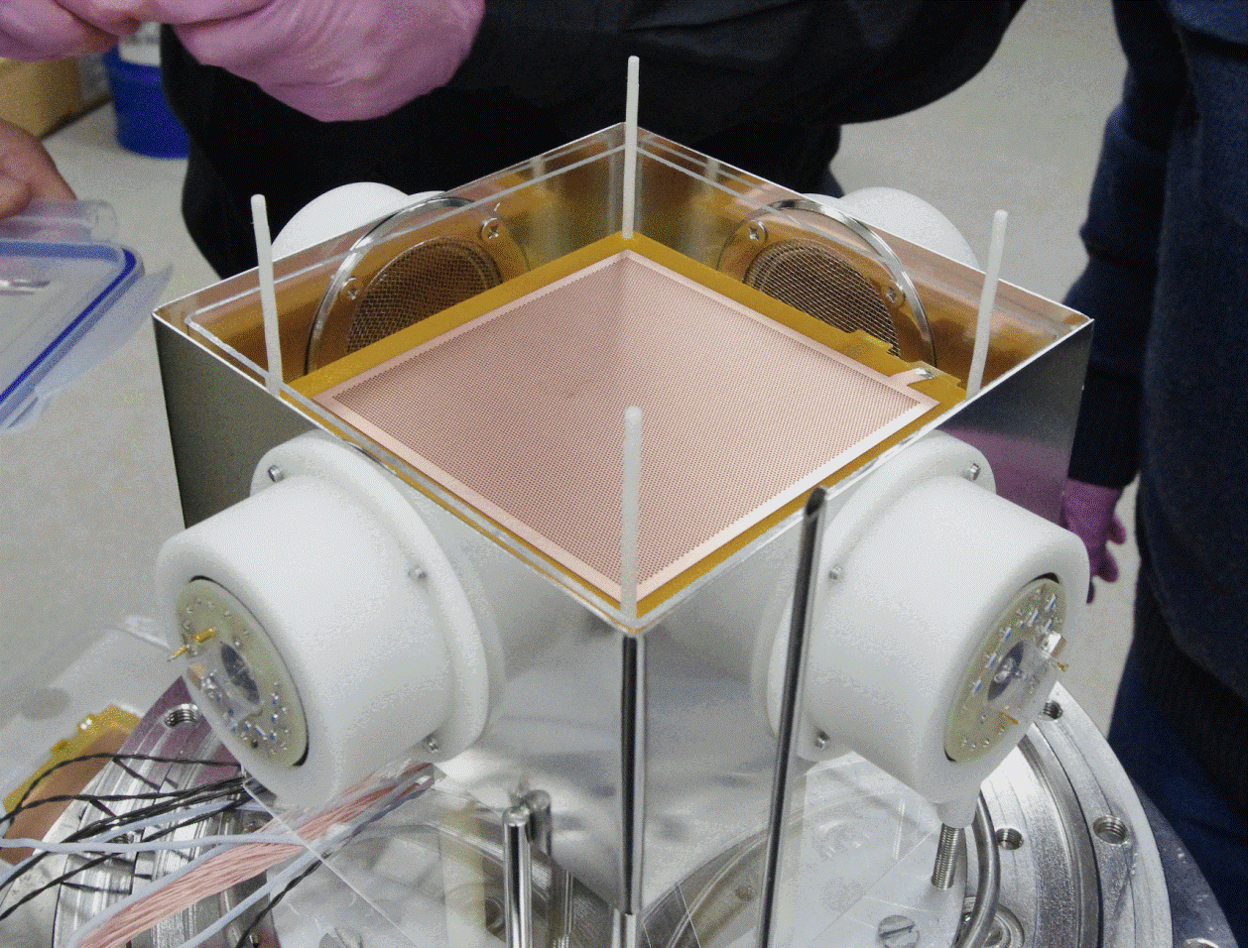
Setup Assembly
Extraction grid: THGEM
12 cm
PMT: Hamamatsu R6041-506-MOD

Slide 7
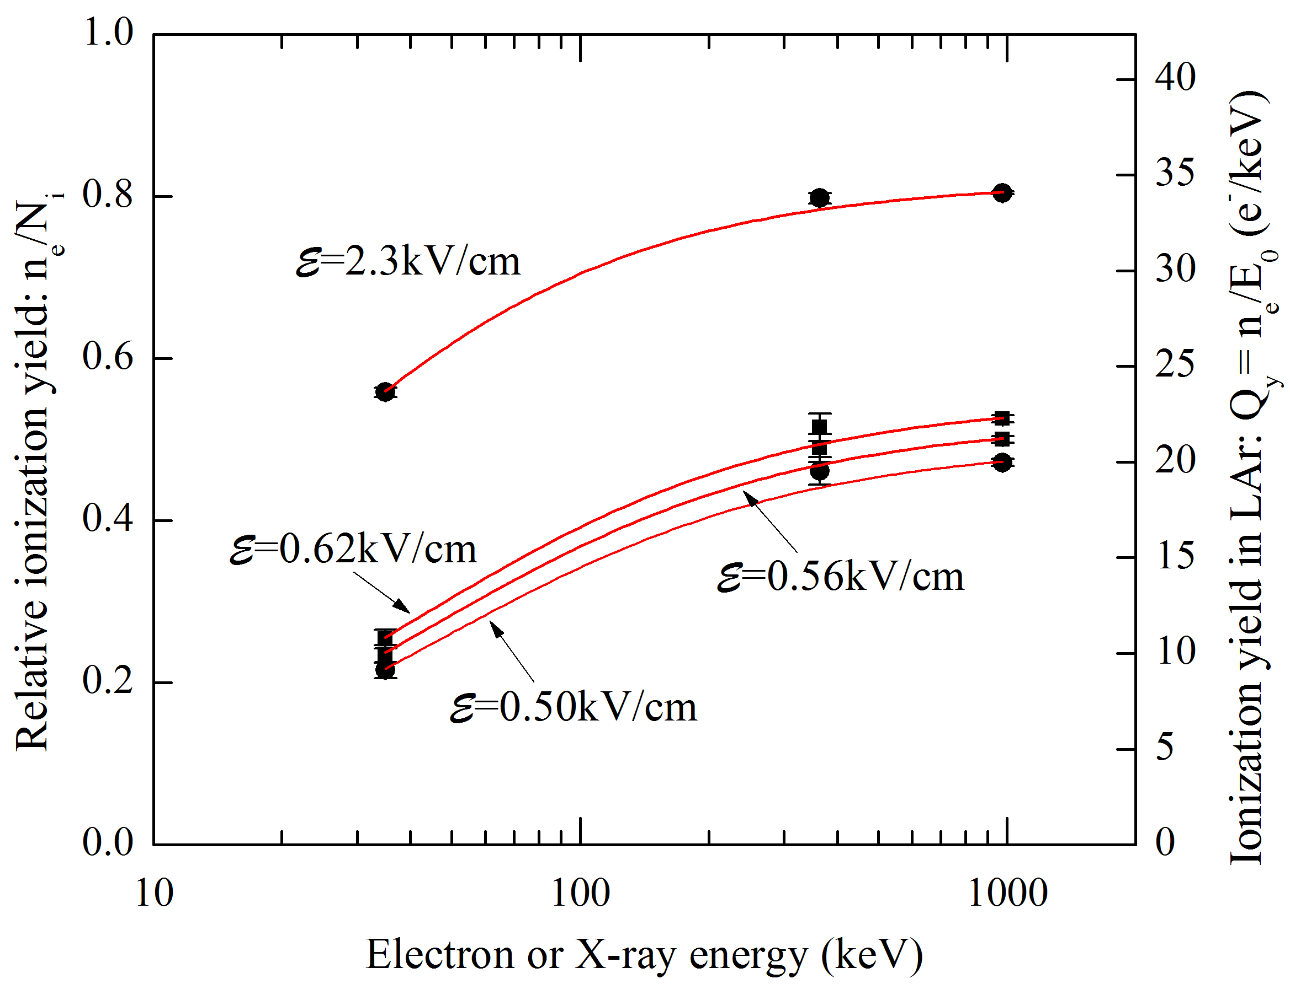
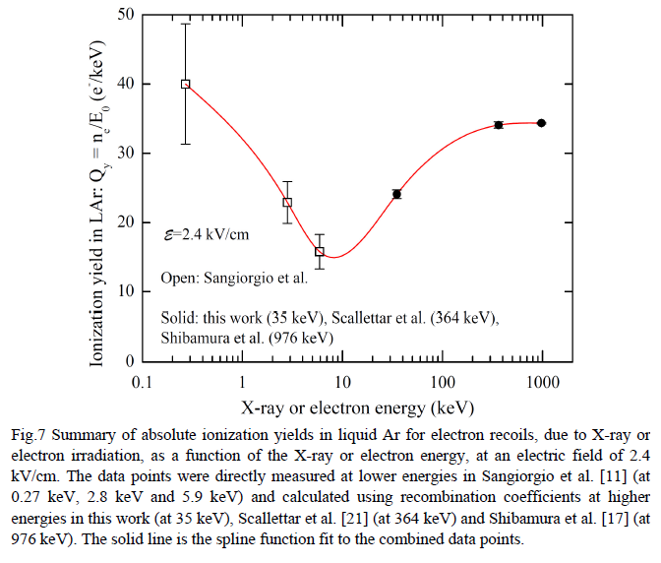
Study of ionization yields of electron recoils in liquid Ar
Recent results on the specific ionization yield depending on the drift field

Slide 8
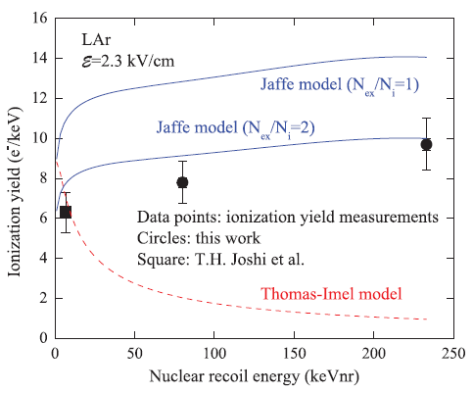
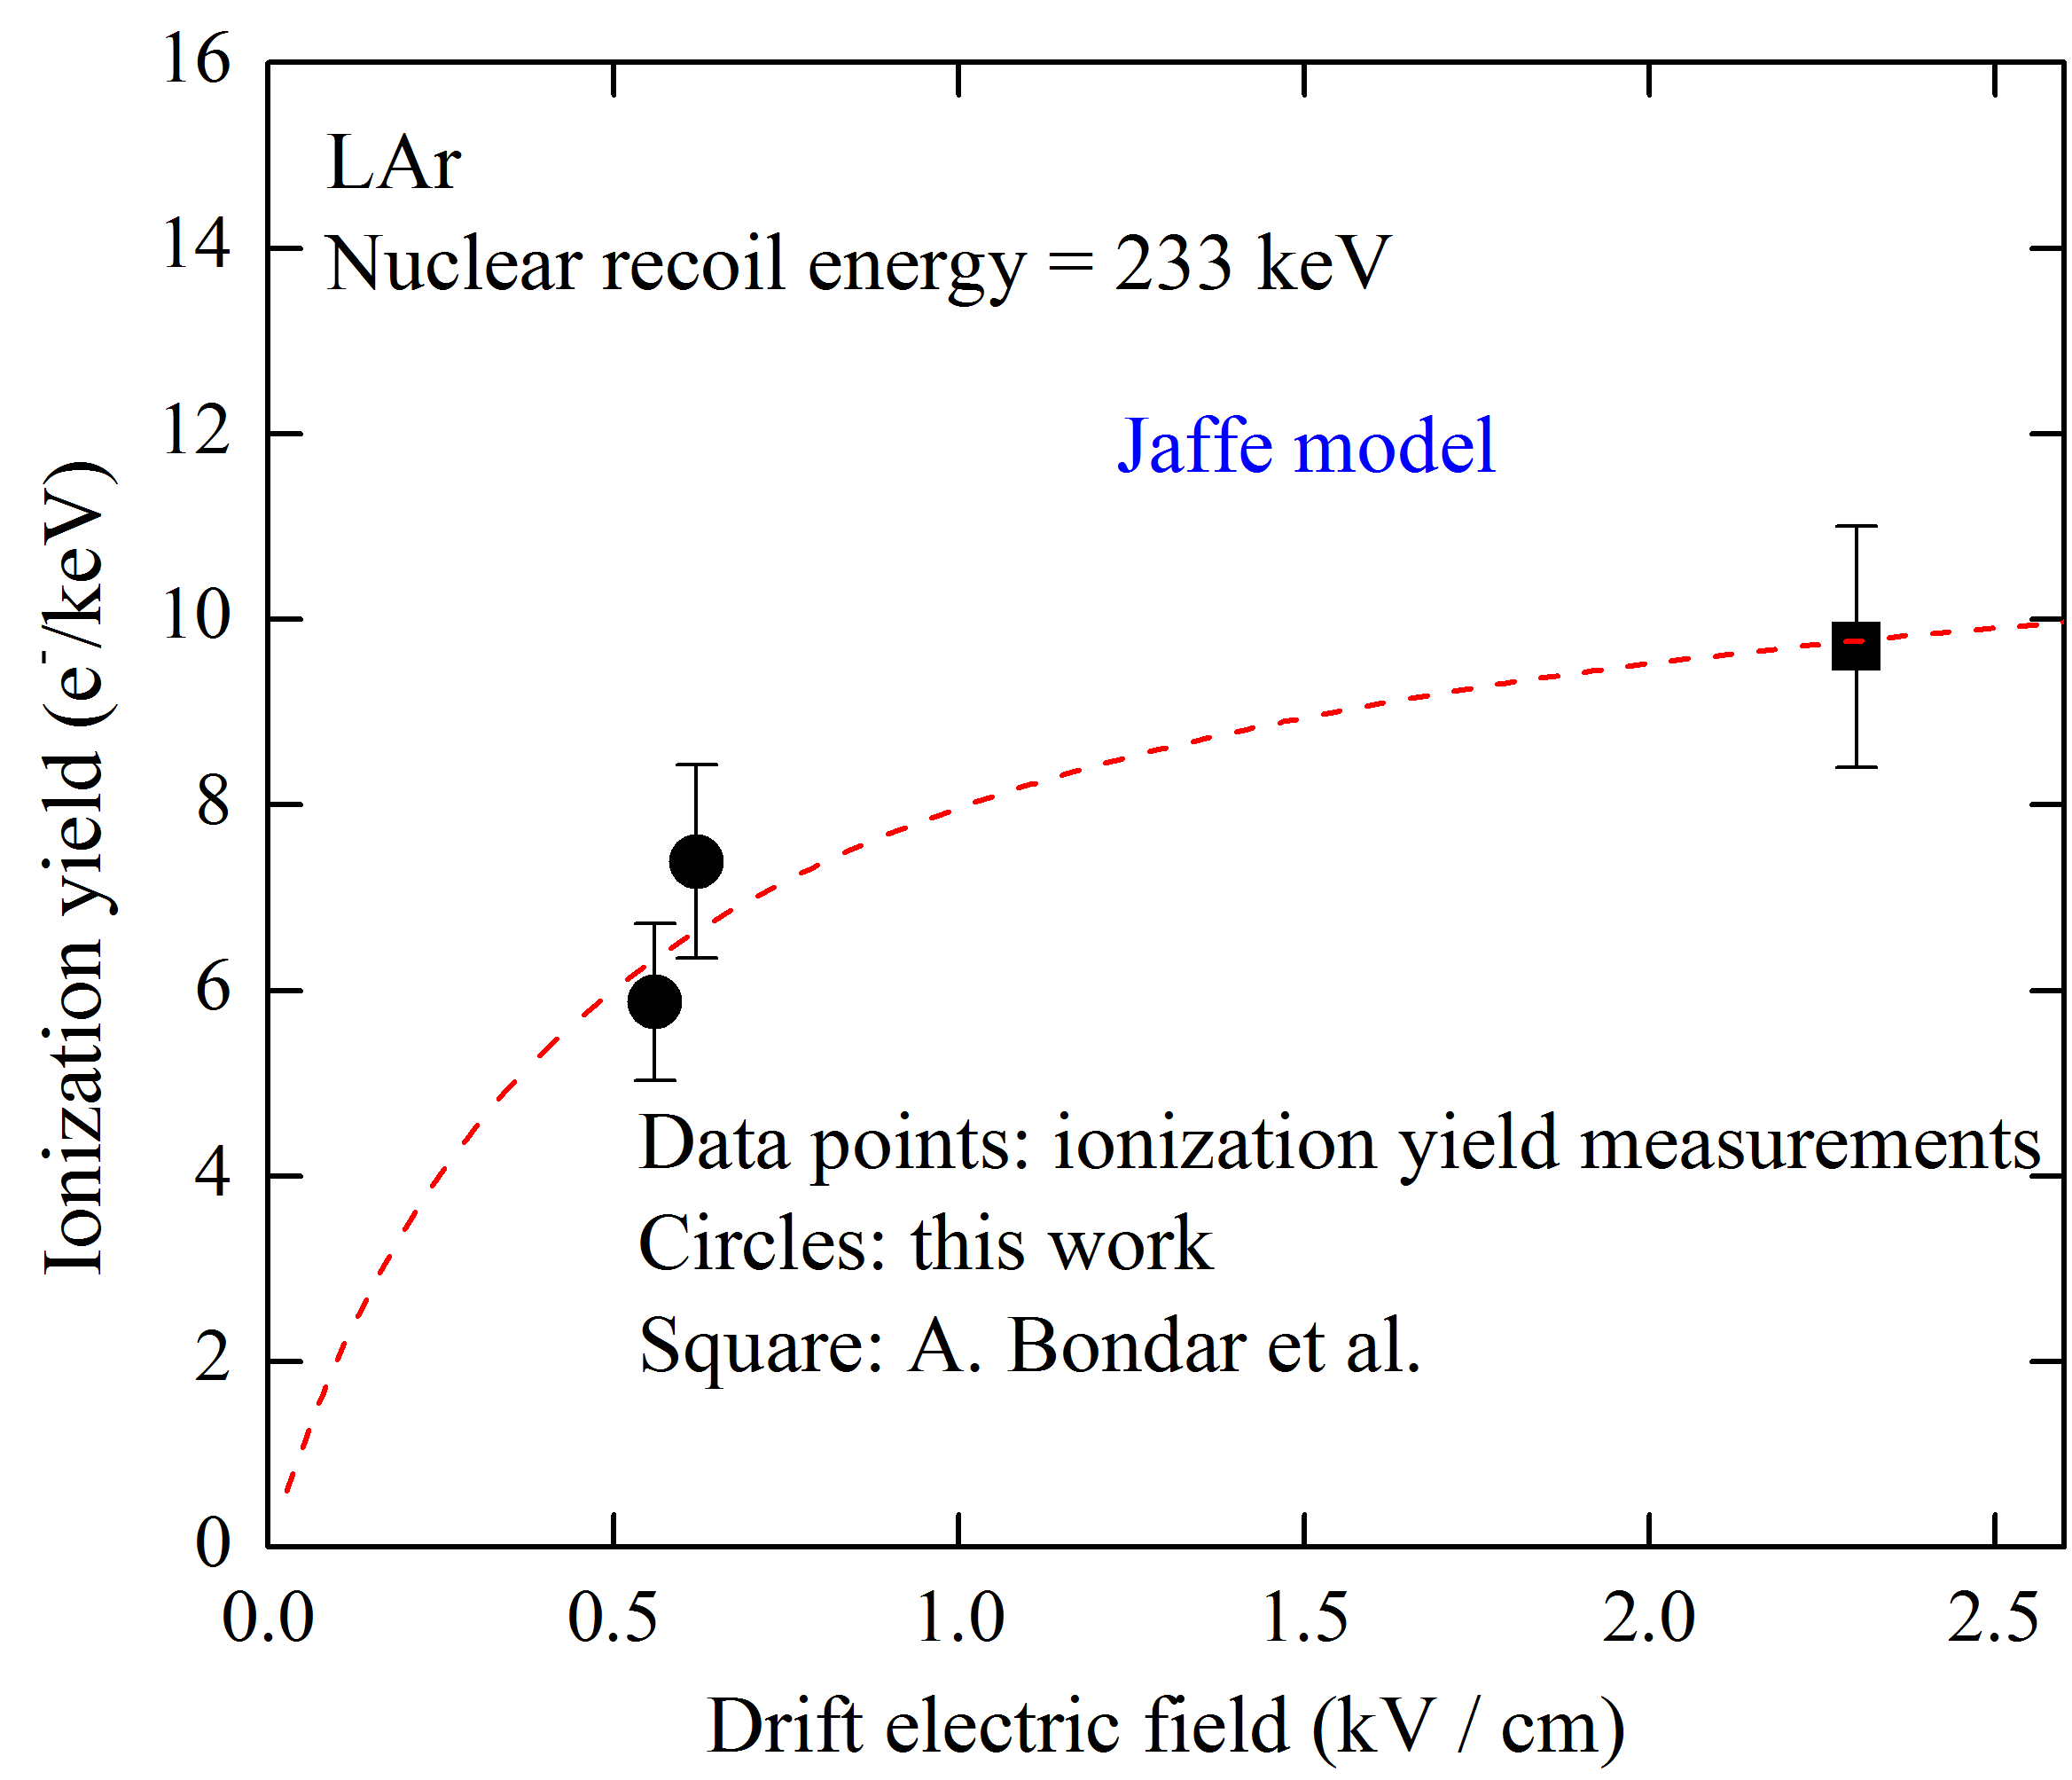
Ionization yield of nuclear recoils in liquid Ar
The ionization quenching factor amounted to 0,30±0.04 for the 233 keV recoil energy and 0,27±0.04 for the 80 keV.
More details: A. Bondar et al. EPL, 108 (2014) 12001

Slide 9
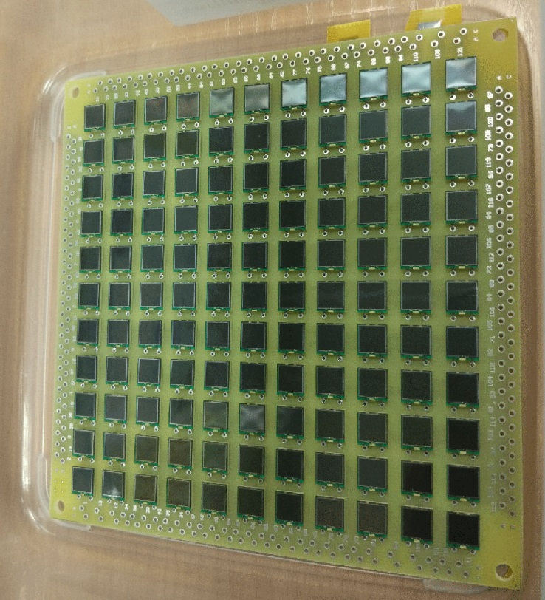
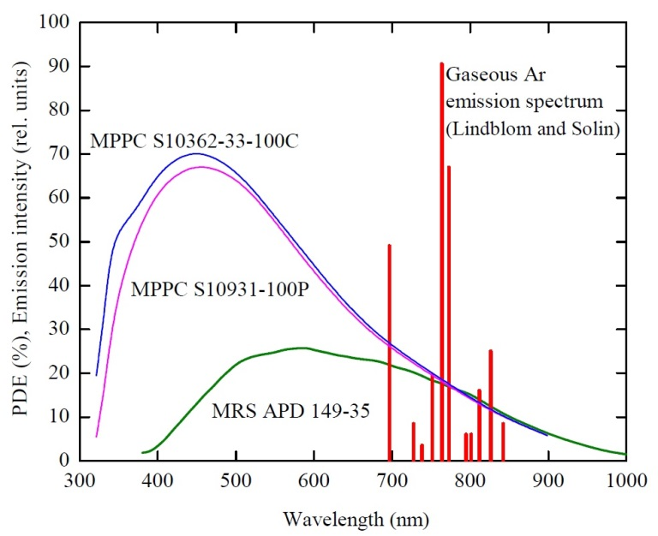
SiPM matrix
Hamamatsu S13360-6050PE
6x6 mm²
Can detect argon light emission in the NUV (300-400 nm) and NIR (700 – 850 nm)

Slide 10
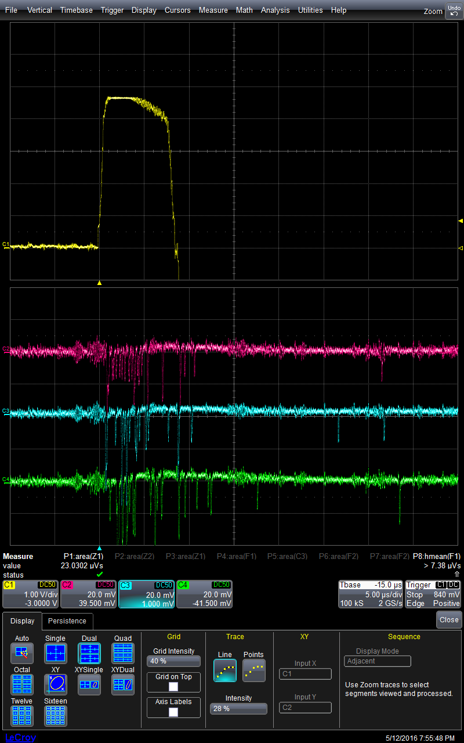
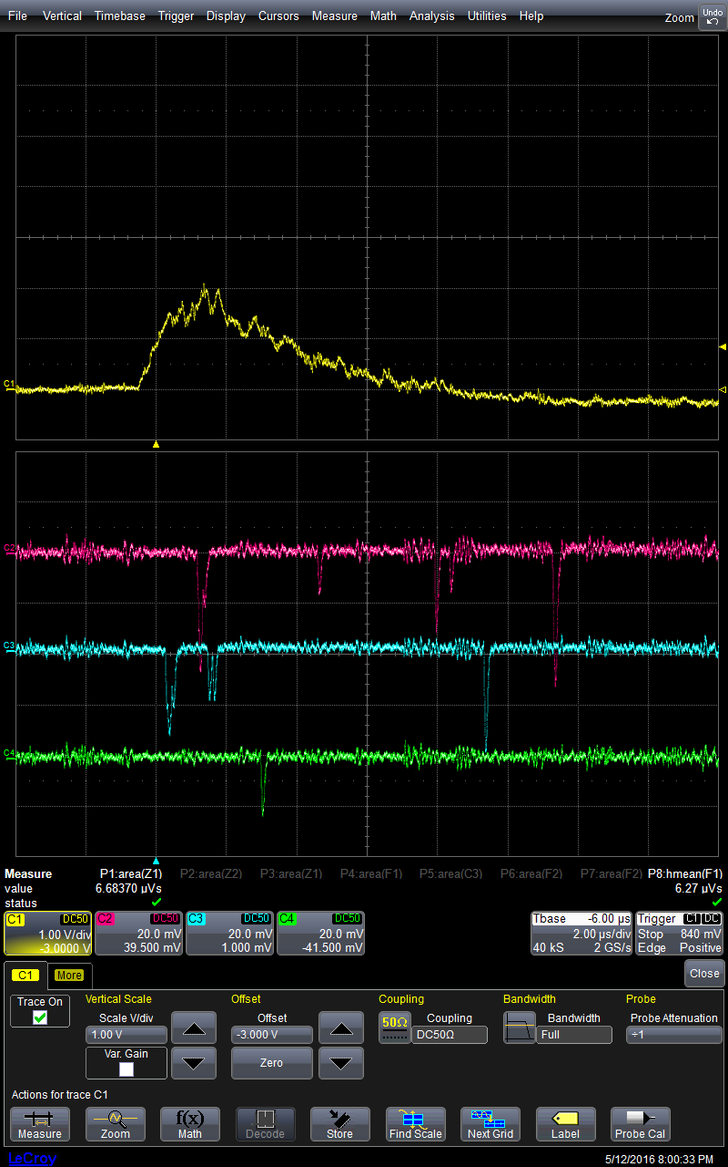
Cosmic ray events
Side PMTs
Central SiPMs

Slide 11
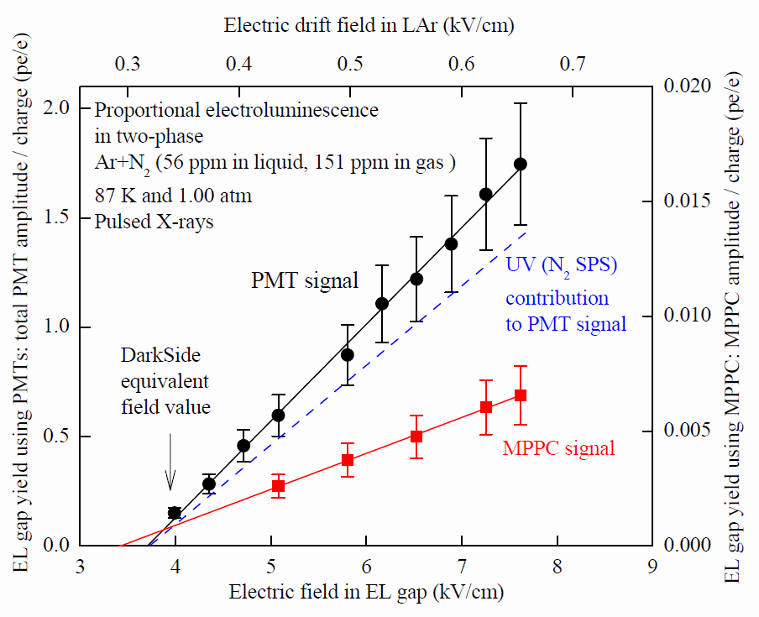
EL gap yield: PMT vs MPPC signal
- High EL gap yield, reaching 1.5 pe/e at 7 kV/cm
- The PMT signal amplitude is a factor of 3 larger than expected from VUV emission due to Ar excimers
- The presence of the MPPC signal indicates on the substantial non-VUV contribution, presumably due to N₂ emission in the near UV (~56 ppm of N₂ in LAr)

